Slide 1
Lecture 12: Clustering

Slide 2
Reading
Chapter 23

Slide 3
Machine Learning Paradigm
Observe set of examples: training data
Infer something about process that generated that data
Use inference to make predictions about previously unseen data: test data
Supervised: given a set of feature/label pairs, find a rule that predicts the label associated with a previously unseen input
Unsupervised: given a set of feature vectors (without labels) group them into “natural clusters”

Slide 4
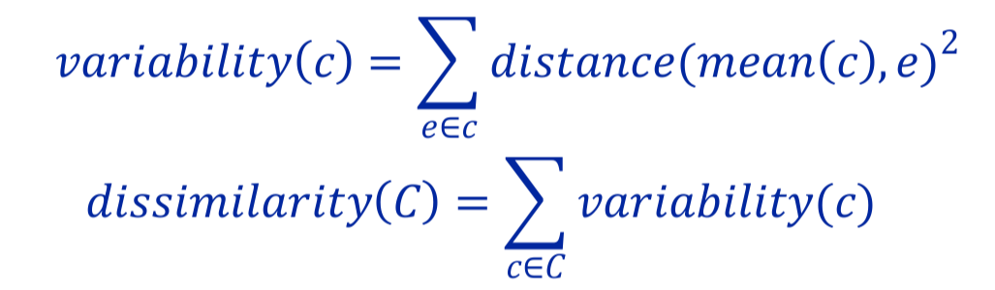
Clustering Is an Optimization Problem
Why not divide variability by size of cluster?
Big and bad worse than small and bad
Is optimization problem finding a C that minimizes
dissimilarity(C)?
No, otherwise could put each example in its own cluster
Need a constraint, e.g.,
Minimum distance between clusters
Number of clusters

Slide 5
Two Popular Methods
Hierarchical clustering
K-means clustering

Slide 6
Hiearchical Clustering
Start by assigning each item to a cluster, so that if you have N items, you now have N clusters, each containing just one item.
Find the closest (most similar) pair of clusters and merge them into a single cluster, so that now you have one fewer cluster.
Continue the process until all items are clustered into a single cluster of size N.
What does distance mean?

Slide 7
Linkage Metrics
Single-linkage: consider the distance between one cluster and another cluster to be equal to the shortest distance from any member of one cluster to any member of the other cluster
Complete-linkage: consider the distance between one cluster and another cluster to be equal to the greatest distance from any member of one cluster to any member of the other cluster
Average-linkage: consider the distance between one cluster and another cluster to be equal to the average distance from any member of one cluster to any member of the other cluster

Slide 8
Example of Hierarchical Clustering
 | BOS | NY | CHI | DEN | SF | SEA
BOS | 0 | 206 | 963 | 1949 | 3095 | 2979
NY |  | 0 | 802 | 1771 | 2934 | 2815
CHI |  |  | 0 | 966 | 2142 | 2013
DEN |  |  |  | 0 | 1235 | 1307
SF |  |  |  |  | 0 | 808
SEA |  |  |  |  |  | 0
{BOS} | {NY} | {CHI} | {DEN} | {SF} | {SEA}
{BOS, NY} |  | {CHI} | {DEN} | {SF} | {SEA}
{BOS, NY, CHI} |  | {DEN} |  | {SF} | {SEA}
{BOS, NY, CHI} |  | {DEN} |  | {SF, SEA}
{BOS, NY, CHI, DEN}
{BOS, NY, CHI}
{SF, SEA} Single linkage
{DEN, SF, SEA} Complete linkage
or

Slide 9
Clustering Algorithms
Hierarchical clustering
Can select number of clusters using dendogram
Deterministic
Flexible with respect to linkage criteria
Slow
Naïve algorithm n³
n² algorithms exist for some linkage criteria
K-means a much faster greedy algorithm
Most useful when you know how many clusters you want

Slide 10
K-means Algorithm
randomly chose k examples as initial centroids while true:
create k clusters by assigning each example to closest centroid
compute k new centroids by averaging examples in each cluster
if centroids don’t change: break
What is complexity of one iteration?
k*n*d, where n is number of points and d time required to compute the distance between a pair of points

Slide 11
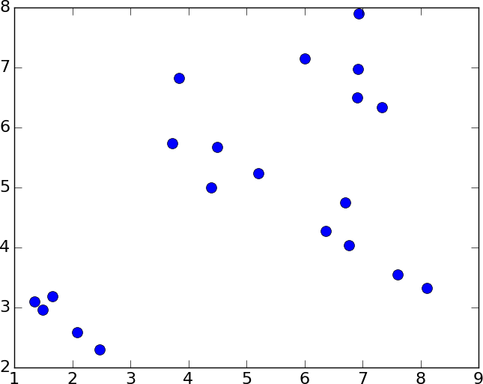
An Example

Slide 12
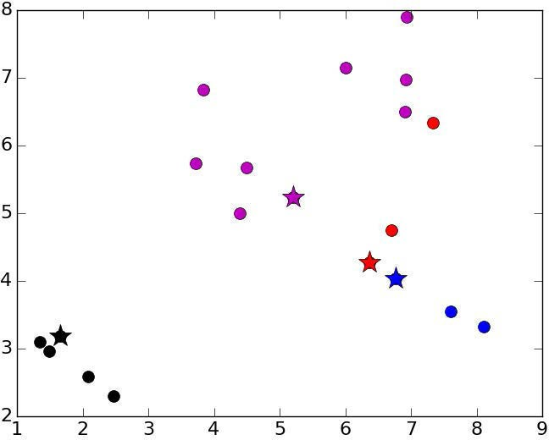
K = 4, Initial Centroids

Slide 13
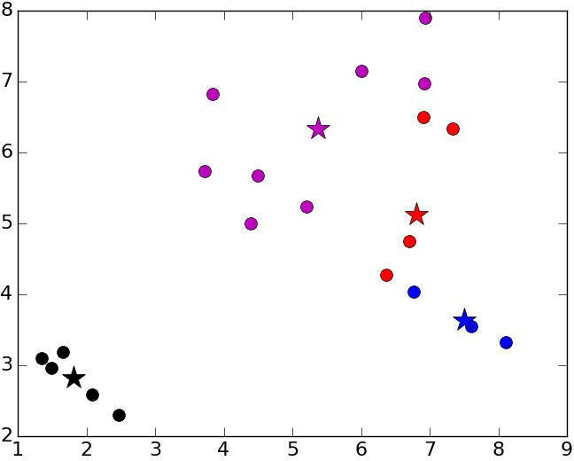
Iteration 1

Slide 14
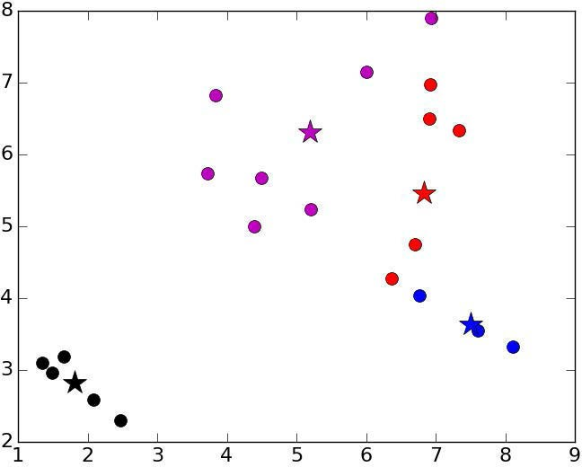
Iteration 2

Slide 15
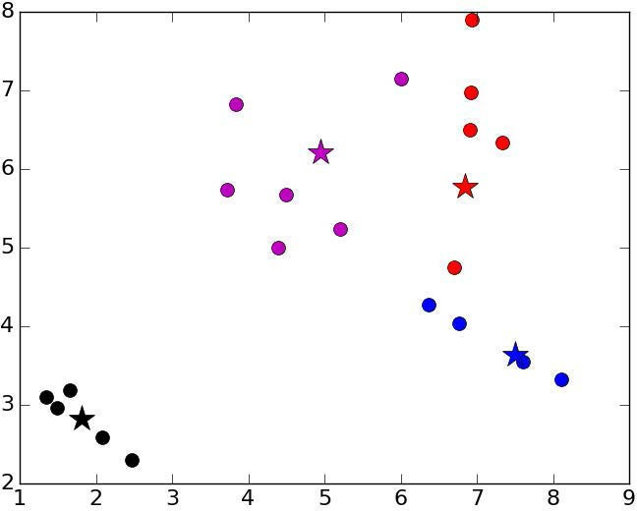
Iteration 3

Slide 16
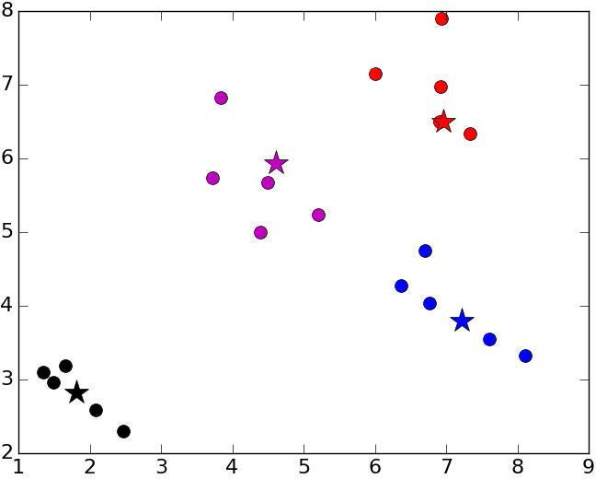
Iteration 4

Slide 17
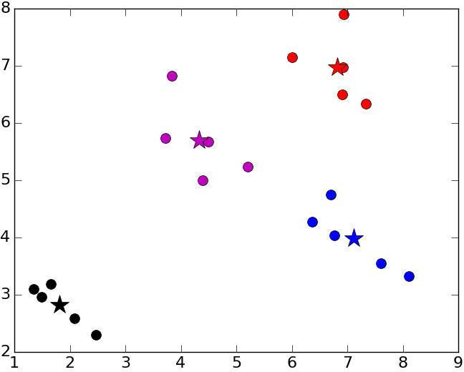
Iteration 5

Slide 18
Issues with k-means
Choosing the “wrong” k can lead to strange results
Consider k = 3
Result can depend upon initial centroids
Number of iterations
Even final result
Greedy algorithm can find different local optimas

Slide 19
How to Choose K
A priori knowledge about application domain
There are two kinds of people in the world: k = 2
There are five different types of bacteria: k = 5
Search for a good k
Try different values of k and evaluate quality of results
Run hierarchical clustering on subset of data

Slide 20
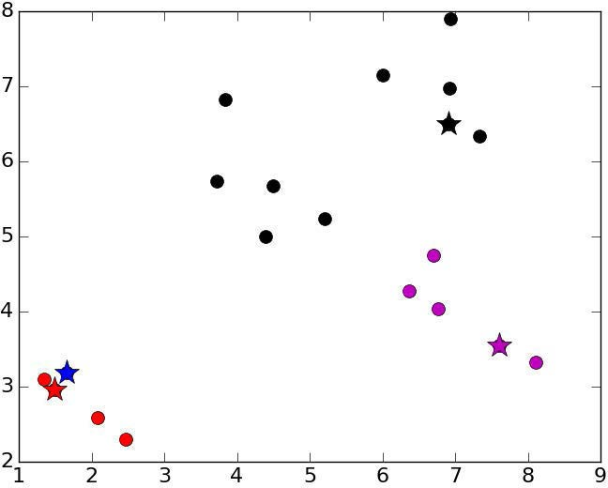
Unlucky Initial Centroids

Slide 21
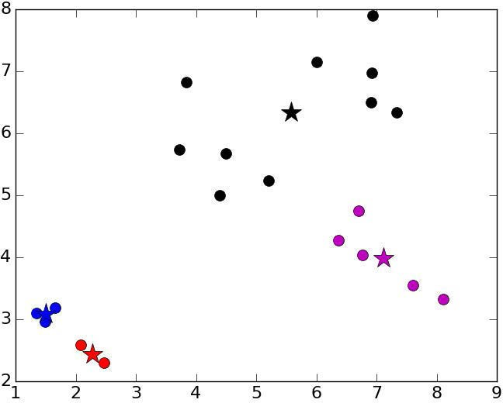
Converges On

Slide 22
Mitigating Dependence on Initial Centroids
Try multiple sets of randomly chosen initial centroids
Select “best” result
best = kMeans(points)
for t in range(numTrials): C = kMeans(points)
if dissimilarity(C) < dissimilarity(best): best = C
return best

Slide 23
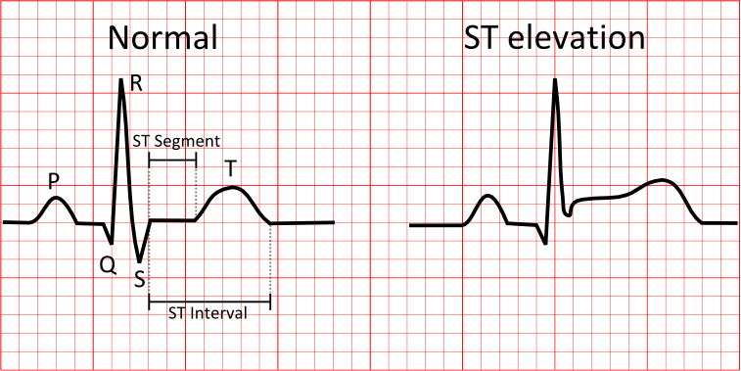
An Example
Many patients with 4 features each
Heart rate in beats per minute
Number of past heart attacks
Age
ST elevation (binary)
Outcome (death) based on features
Probabilistic, not deterministic
E.g., older people with multiple heart attacks at higher risk
Cluster, and examine purity of clusters relative to outcomes

Slide 24
Data Sample
HR Att STE Age Outcome
P000:[ 89. | 1. | 0. | 66.]:1
P001:[ 59. | 0. | 0. | 72.]:0
P002:[ 73. | 0. | 0. | 73.]:0
P003:[ 56. | 1. | 0. | 65.]:0
P004:[ 75. | 1. | 1. | 68.]:1
P005:[ 68. | 1. | 0. | 56.]:0
P006:[ 73. | 1. | 0. | 75.]:1
P007:[ 72. | 0. | 0. | 65.]:0
P008:[ 73. | 1. | 0. | 64.]:1
P009:[ 73. | 0. | 0. | 58.]:0
P010:[ 100. | 0. | 0. | 75.]:0
P011:[ 79. | 0. | 0. | 31.]:0
P012:[ 81. | 0. | 0. | 58.]:0
P013:[ 89. | 1. | 0. | 50.]:1
P014:[ 81. | 0. | 0. | 70.]:0

Slide 25
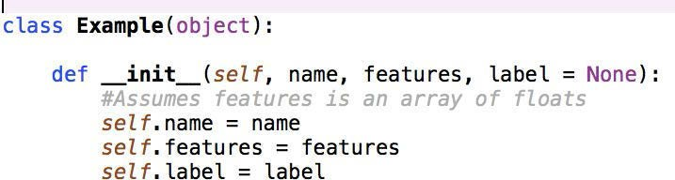
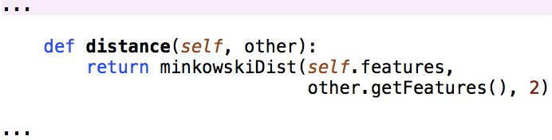
Class Example

Slide 26
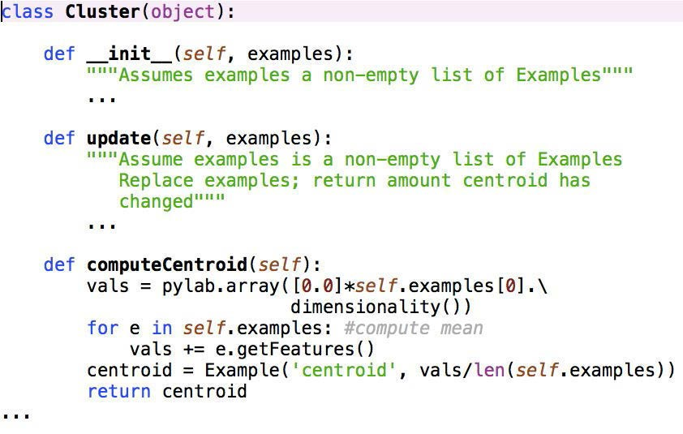
Class Cluster

Slide 27
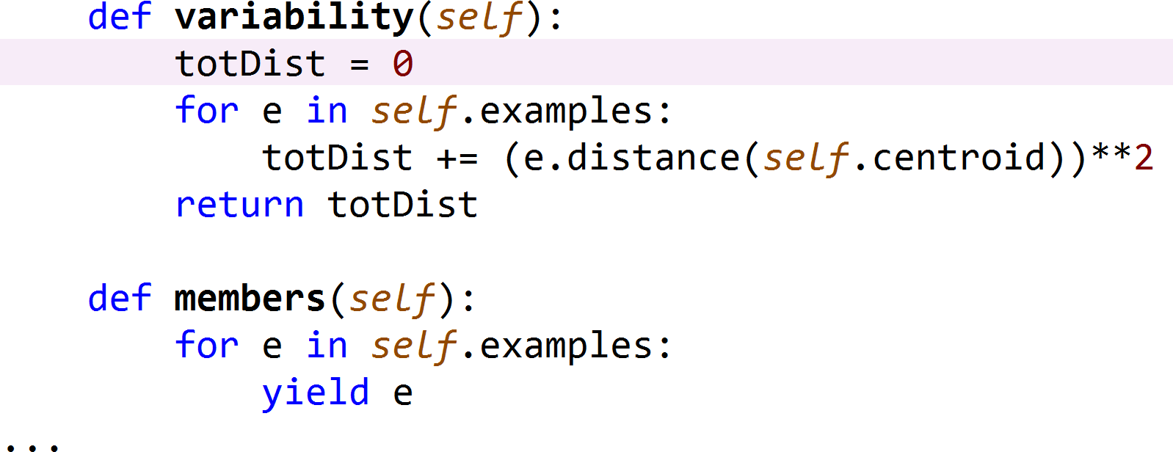
Class Cluster, cont.

Slide 28
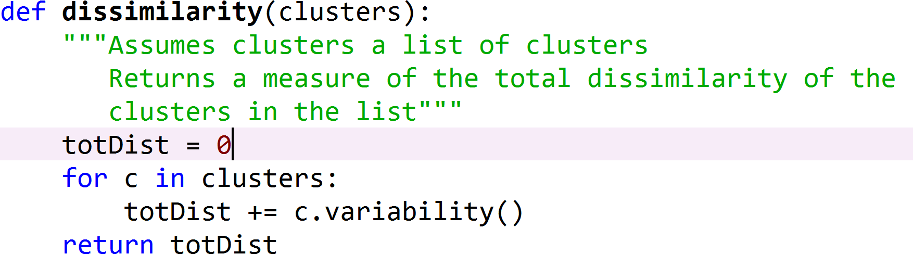
Evaluating a Clustering

Slide 29
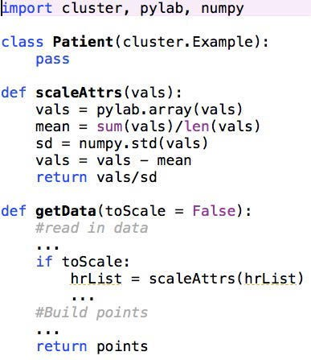
Patients
Z-Scaling Mean = ? Std = ?

Slide 30
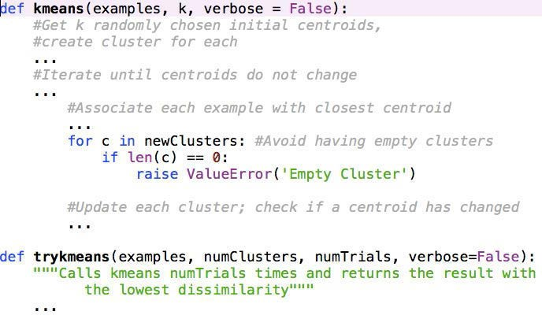
kmeans

Slide 31
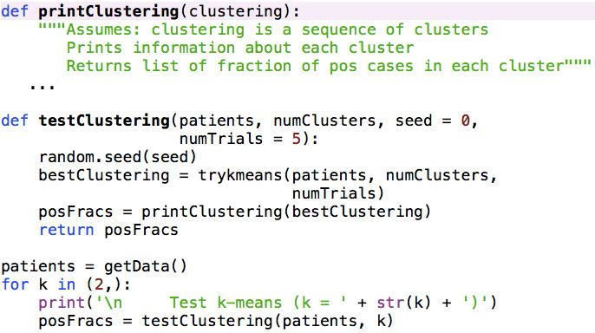
Examining Results

Slide 32
Result of Running It
Test k-means (k = 2)
Cluster of size 118 with fraction of positives = 0.3305 Cluster of size 132 with fraction of positives = 0.3333
Like it?
Try patients = getData(True) Test k-means (k = 2)
Cluster of size 224 with fraction of positives = 0.2902 Cluster of size 26 with fraction of positives = 0.6923
Happy with sensitivity?

Slide 33
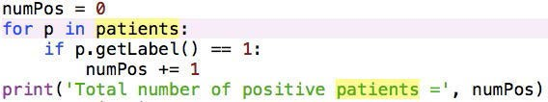
How Many Positives Are There?
Total number of positive patients = 83
Test k-means (k = 2)
Cluster of size 224 with fraction of positives = 0.2902 Cluster of size 26 with fraction of positives = 0.6923

Slide 34
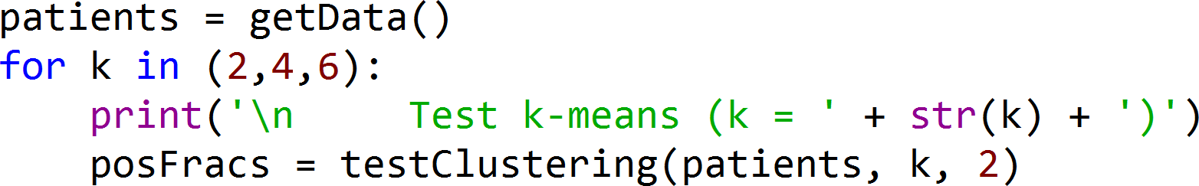
A Hypothesis
Different subgroups of positive patients have different characteristics
How might we test this?
Try some other values of k

Slide 35
Testing Multiple Values of k
Test k-means (k = 2)
Cluster of size 224 with fraction of positives = 0.2902 Cluster of size 26 with fraction of positives = 0.6923
Test k-means (k = 4)
Cluster of size 26 with fraction of positives = 0.6923
Cluster of size 86 with fraction of positives = 0.0814 Cluster of size 76 with fraction of positives = 0.7105 Cluster of size 62 with fraction of positives = 0.0645
Test k-means (k = 6)
Cluster of size 49 with fraction of positives = 0.0204
Cluster of size 26 with fraction of positives = 0.6923 Cluster of size 45 with fraction of positives = 0.0889 Cluster of size 54 with fraction of positives = 0.0926 Cluster of size 36 with fraction of positives = 0.7778 Cluster of size 40 with fraction of positives = 0.675
Pick a k

Slide 36
MIT OpenCourseWare https://ocw.mit.edu
6.0002 Introduction to Computational Thinking and Data Science
Fall 2016
For information about citing these materials or our Terms of Use, visit: https://ocw.mit.edu/terms.

